Slide 1

Project 1
UK Food Trends
Abraham, Helen, Kassem & Rahmi

Slide 2

Introduction
Our presentation will look at the UK Food trends since the turn of the millenium.
We've used data from the UK government website on food and farming.
After going through all the choices between API's and Datasets we picked the UK household family food datasets. This contained detailed information on UK household purchases include statistics.
These spreadsheets are updated annually when a new edition of the ‘Family Food’ report is published.
Our aim was to identify food and drink trends as well as finding the underlying information from the data to see trends of the most popular food and drink and plotting the variables for our topic areas to identify key findings.
we've provided different breakdowns within our visuals to the UK averages figures by age characteristics.

Slide 3

Methodology

Slide 4
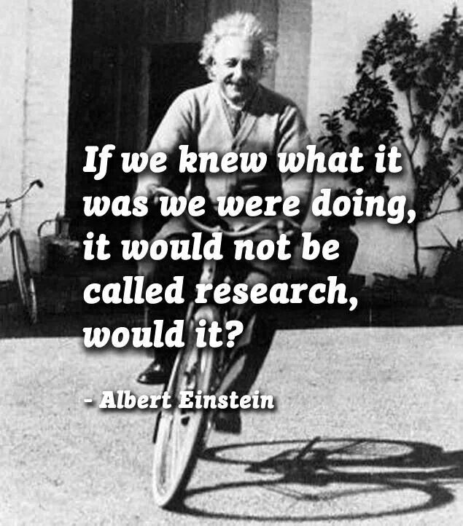

Research is formalized curiosity. It is poking and prying with a purpose
— Zorah Neal Hurtson

Slide 5
Our Methodology
We found data from UK Gov websites for Farming and food containing various information related to our area. we narrowed down to look at food trends since the turn of the century looking at popularity of food and drink by uk household at various age groups.
Initial data exploration was done to better understand and visually identify anomalies within the data as well as focus our reaserch to which area's we wished to explore.When this process concluded we decided on our data set's but instead of picking one data set we have pooled various data sets together to which we created our data frame rather than take an already construct and available one.
The we split the questions amongst the group and produced the relevant code to give us answers to our questions.

Slide 6


The Dataset
a little background on our data set ......
11 Food Categories
23 Food Groups
169 Major Food Categories
134 Minor Food Categories

Slide 7

The Data & Our Findings

Slide 8
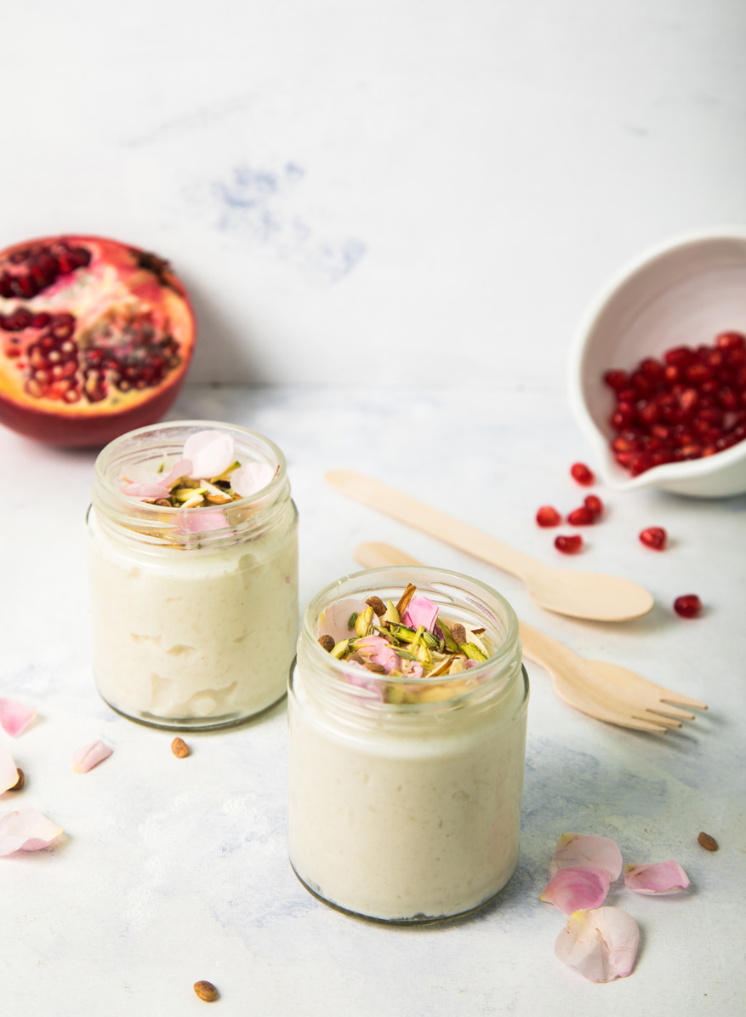
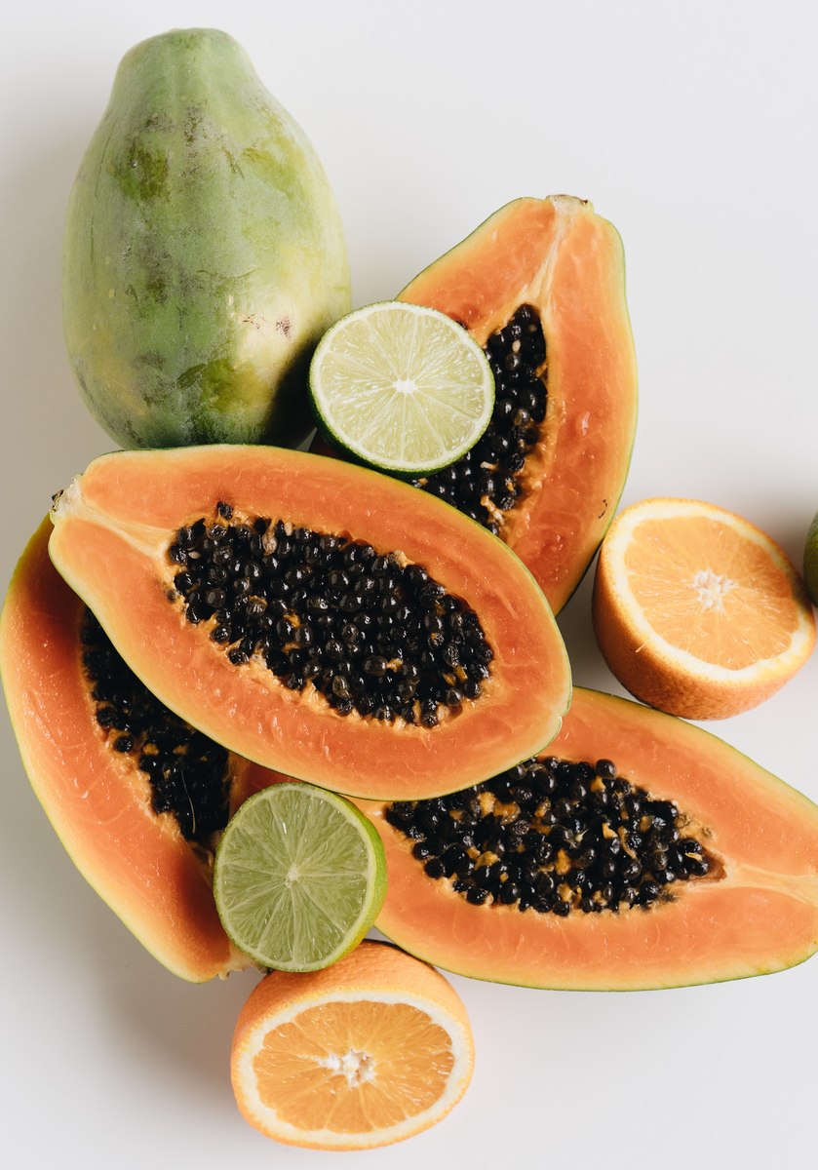
Findings - 1st Level Food Groups
FOOD & SNACKS
DRINK
Briefly elaborate on what you want to discuss.
Briefly elaborate on what you want to discuss.

Slide 9
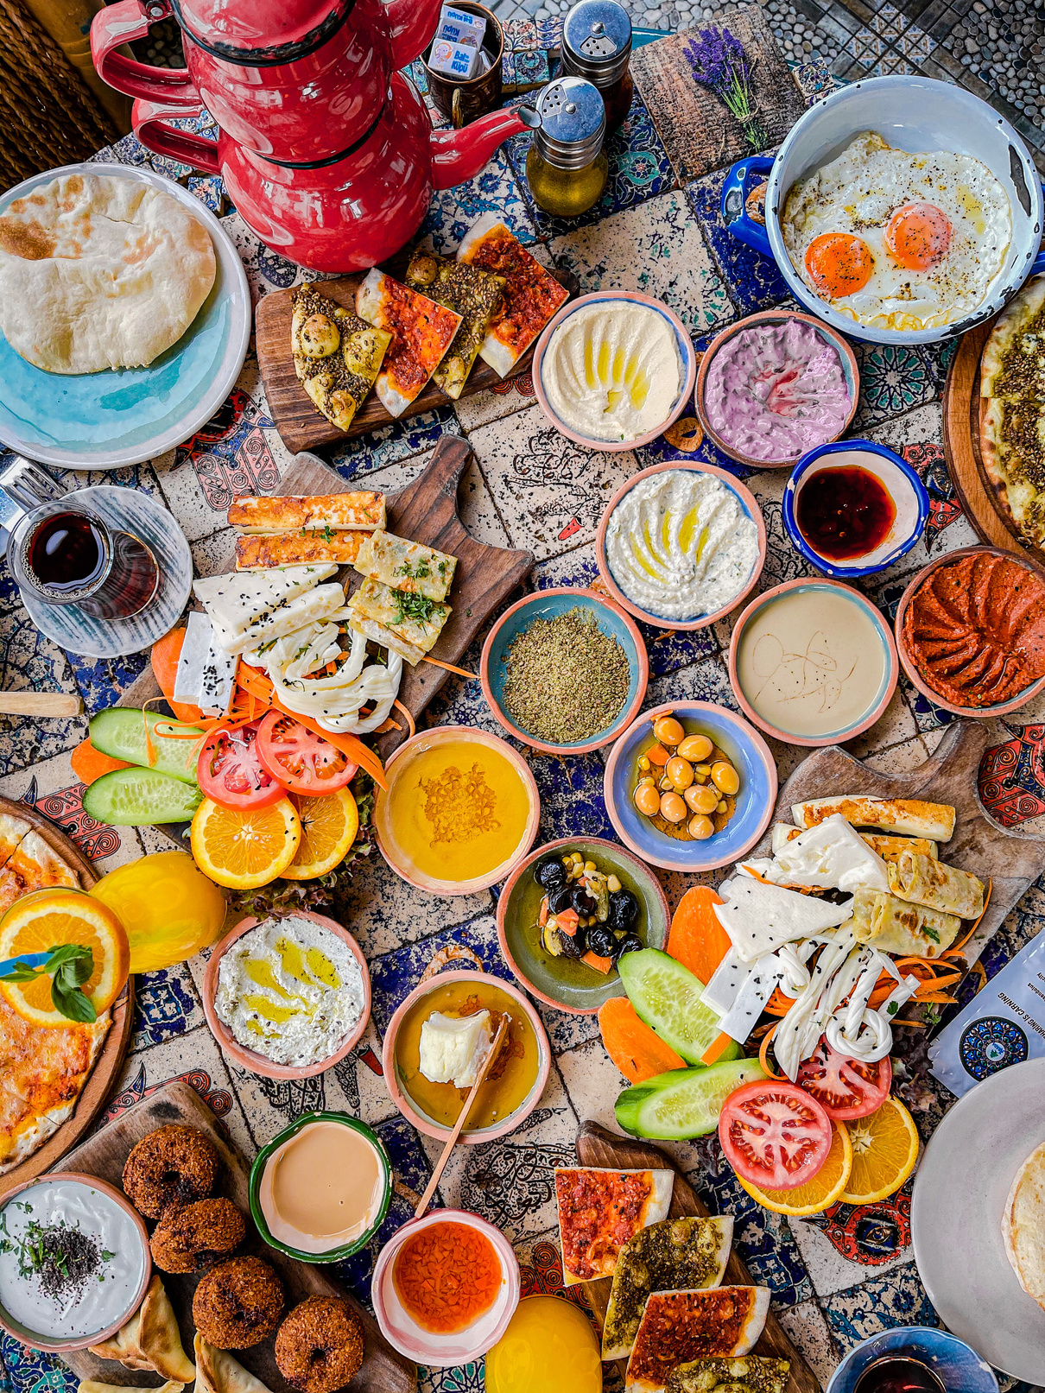
Total Food & Drink Consumption
Use this for a photo caption.

Slide 10
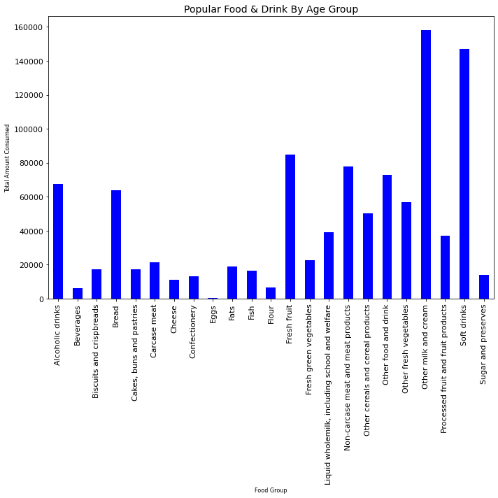

Key Points
most popular food by total average consumption per person
most popular food by total average consumption per person
Special mentions - soft drinks
We will go deep dive further detail throughout the presentations

Slide 11
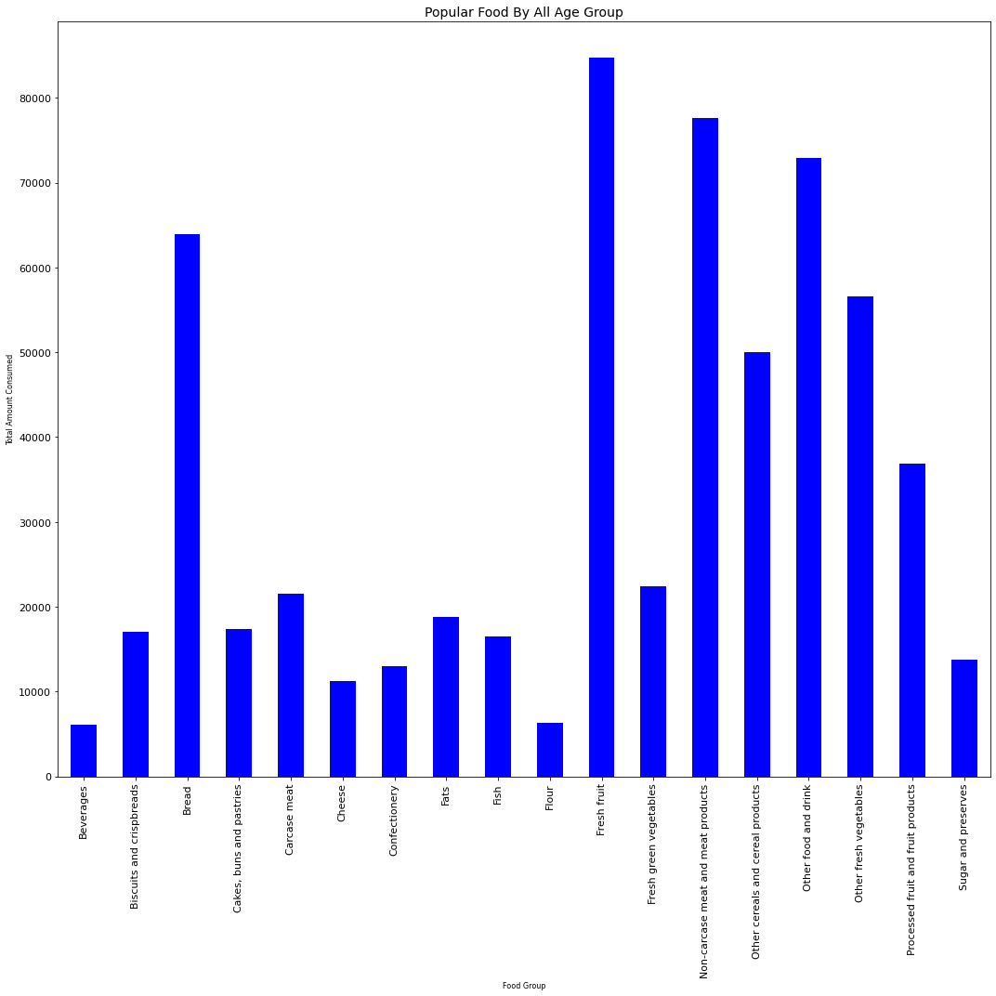
01
ADD A MAIN POINT
Briefly elaborate on what
you want to discuss.
02
ADD A MAIN POINT
Briefly elaborate on what
you want to discuss.
Write your topic or idea

Slide 12
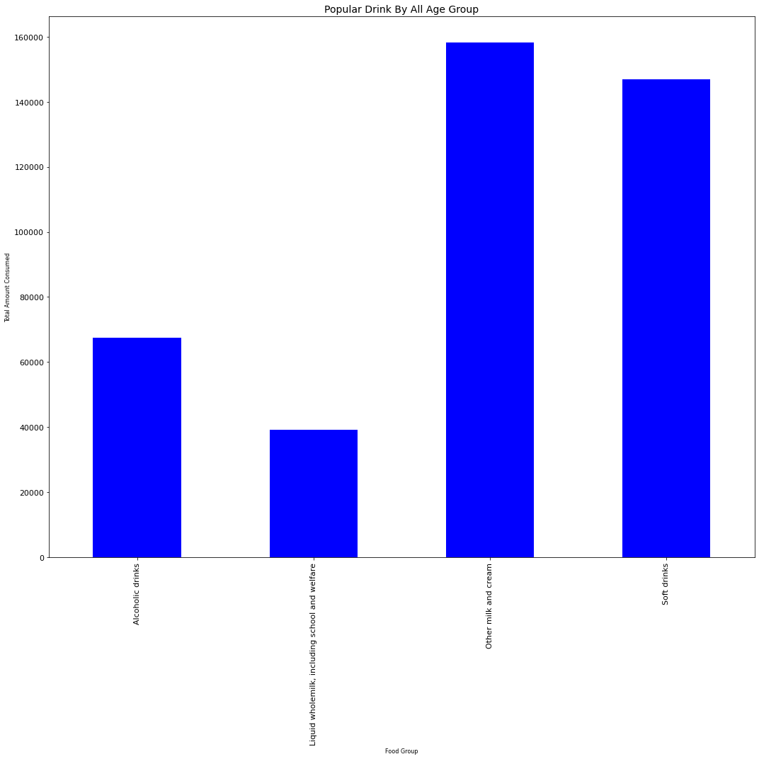
01
ADD A MAIN POINT
Briefly elaborate on what
you want to discuss.
02
ADD A MAIN POINT
Briefly elaborate on what
you want to discuss.
Write your topic or idea

Slide 13

Use this for a photo caption.

Slide 14

Level 2 --

Slide 15
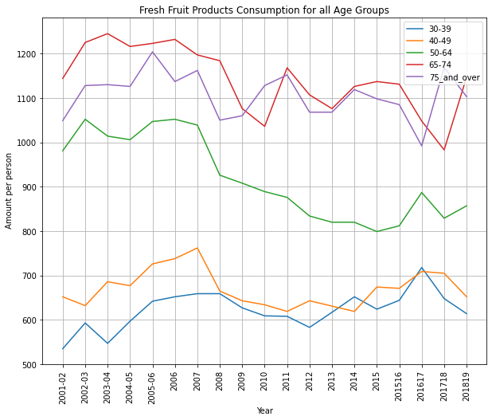
Write
your topic or idea
Briefly elaborate on what
you want to discuss.

Slide 16



Fresh Fruit
ADD A MAIN POINT
ADD A MAIN POINT
ADD A MAIN POINT
Briefly elaborate on what
you want to discuss.
Briefly elaborate on what
you want to discuss.
Briefly elaborate on what
you want to discuss.

Slide 17
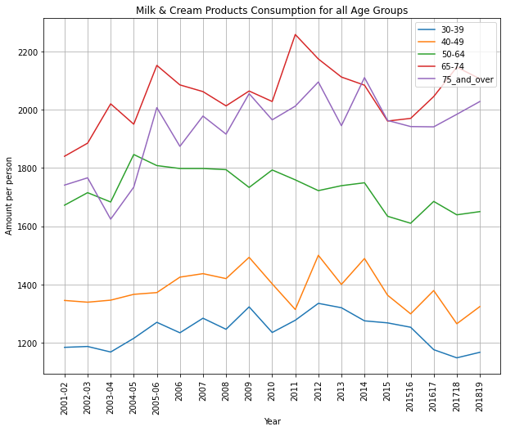
Write
your topic or idea
Briefly elaborate on what
you want to discuss.

Slide 18
Write your topic or idea
01
02
03
ADD A MAIN POINT
ADD A MAIN POINT
ADD A MAIN POINT
Briefly elaborate on what
you want to discuss.
Briefly elaborate on what
you want to discuss.
Briefly elaborate on what
you want to discuss.

Slide 19
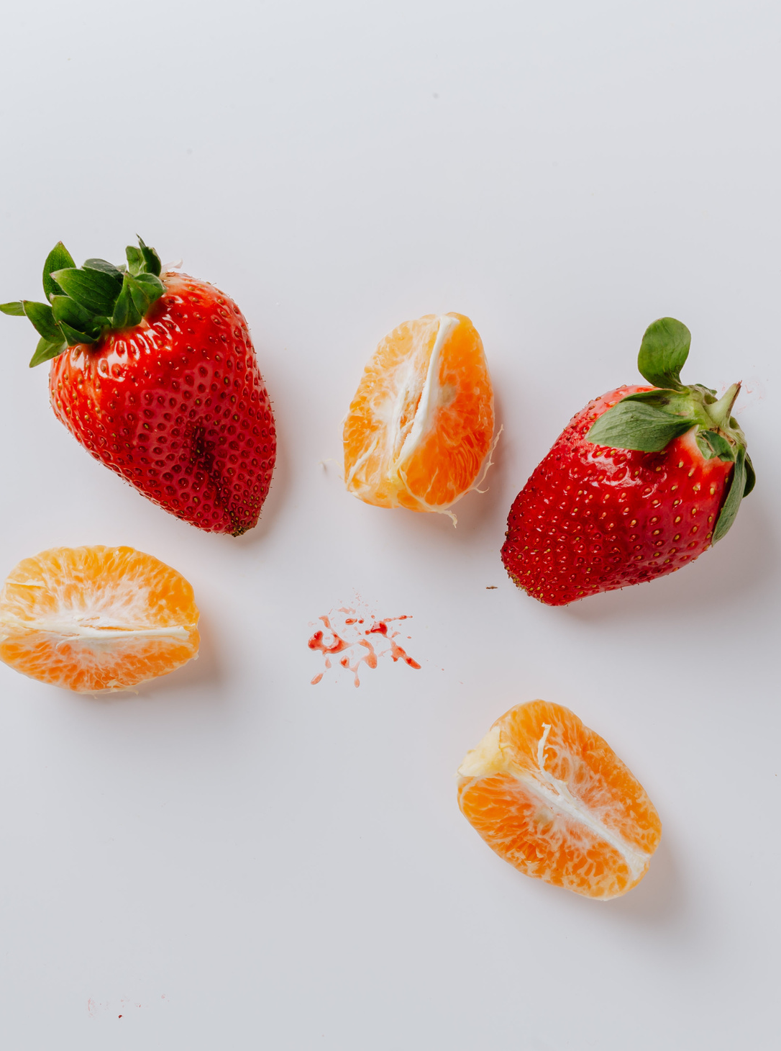
Rahmi - Level 2

Slide 20
Write your topic or idea
01
ADD A MAIN POINT
03
ADD A MAIN POINT
Briefly elaborate on what
you want to discuss.
Briefly elaborate on what
you want to discuss.
02
ADD A MAIN POINT
04
ADD A MAIN POINT
Briefly elaborate on what
you want to discuss.
Briefly elaborate on what
you want to discuss.

Slide 21
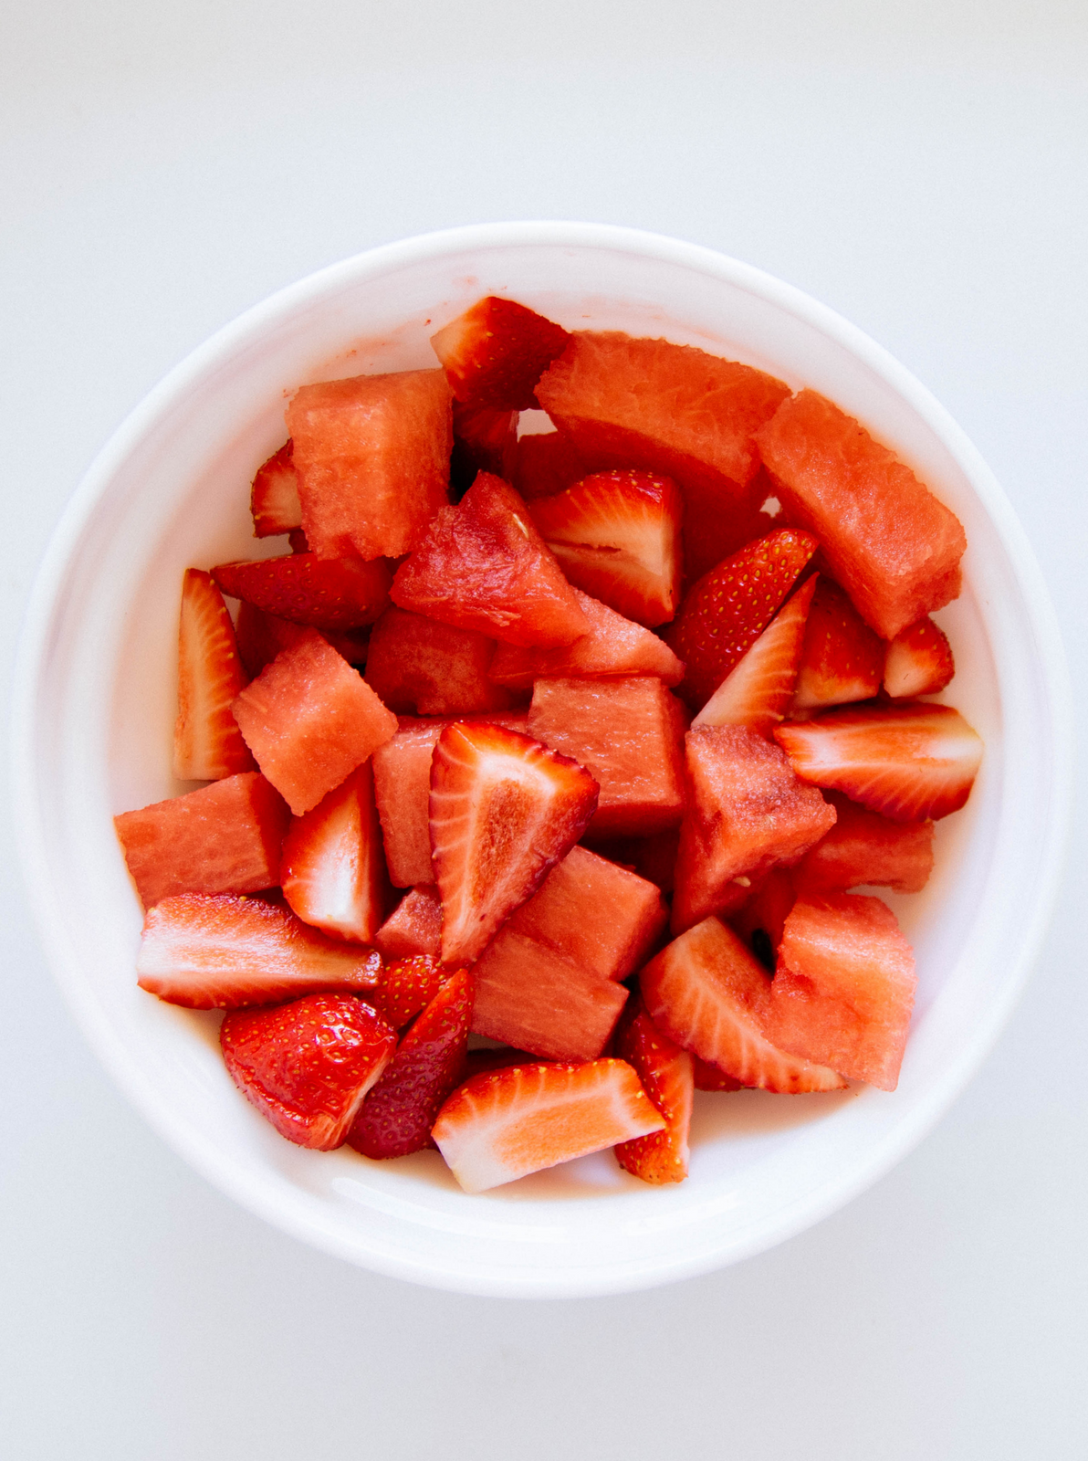
Helen - Level 3
Briefly elaborate on what you want to discuss.

Slide 22
Write your topic or idea
Briefly elaborate on what you want to discuss.
125
100
75
50
25
0
Item 1
Item 2
Item 3
Item 4
Item 5

Slide 23
Item 5
20%
Item 1
20%
Write
your topic or idea
Item 4
20%
Item 2
20%
Briefly elaborate on what
you want to discuss.
Item 3
20%

Slide 24
Write
your topic or idea
ADD A
MAIN POINT
30%
ADD A
MAIN POINT
Briefly elaborate on what
you want to discuss.
60%
ADD A
MAIN POINT
90%

Slide 25

Write your topic or idea
Briefly elaborate on what you want to discuss.

Slide 26
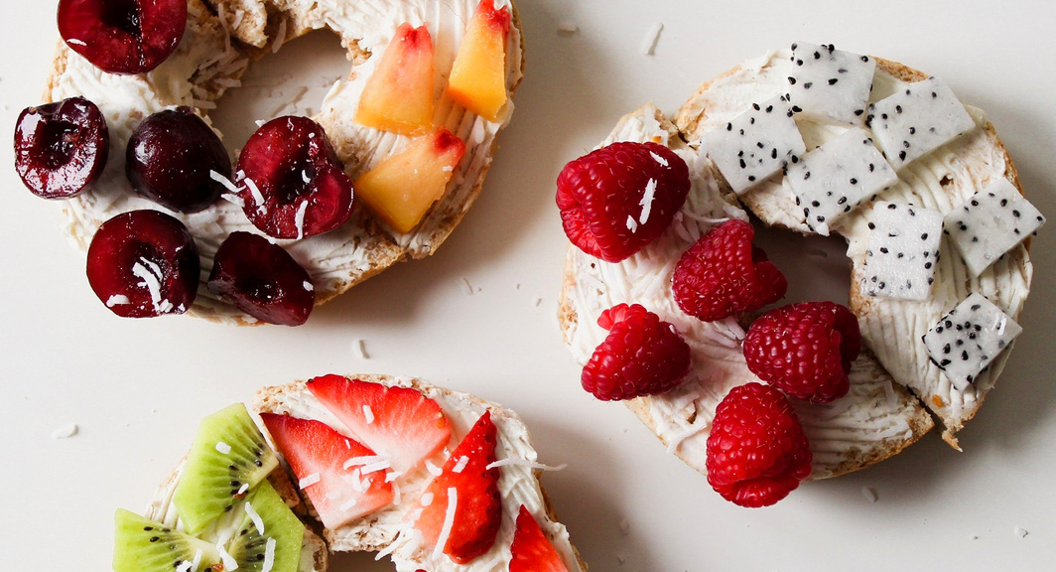
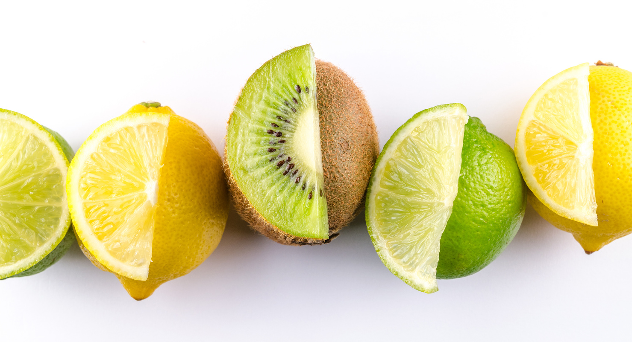
Write your
topic or idea
Briefly elaborate on what you want to discuss.

Slide 27
01
ADD A MAIN POINT
Briefly elaborate on what
you want to discuss.
Write your topic or idea
02
ADD A MAIN POINT
Briefly elaborate on what
you want to discuss.

Slide 28

Write your topic or idea
Briefly elaborate on what you want to discuss.

Slide 29
Write
your topic or idea
3 OUT OF 6
Briefly elaborate on what you want to discuss.
5 OUT OF 6
Briefly elaborate on what you want to discuss.

Slide 30
Add a section header

Slide 31
Write your topic or idea
Briefly elaborate on what you want to discuss.
50
40
30
20
10
0
Item 1
Item 2
Item 3
Item 4
Item 5

Slide 32
Write your topic or idea

Slide 33
Write your topic or idea
01
02
03
04
ADD A MAIN POINT
ADD A MAIN POINT
ADD A MAIN POINT
ADD A MAIN POINT
Briefly elaborate on what you want to discuss.
Briefly elaborate on what you want to discuss.
Briefly elaborate on what you want to discuss.
Briefly elaborate on what you want to discuss.

Slide 34
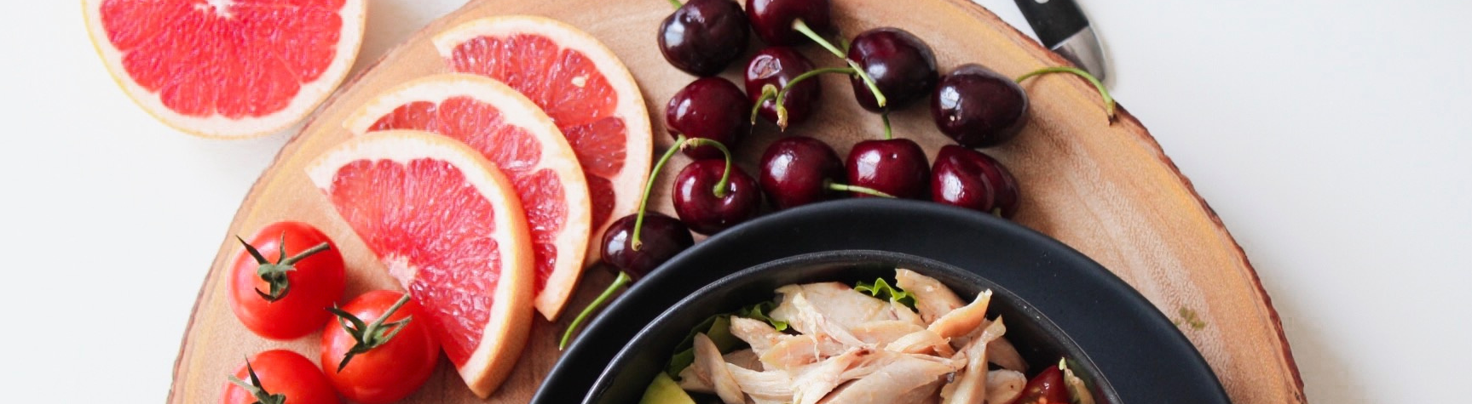
Write your topic or idea
Briefly elaborate on what you want to discuss.

Slide 35

Thank You
Abraham, Helen, Kassem & Rahmi

Slide 36

THE FUTURE BELONGS TO THOSE WHO BELIEVE IN THE BEAUTY OF THEIR DREAMS.
— Eleanor Roosevelt

Slide 37






























Free Resources
Use these elements
in your Canva presentation.

Slide 38
Write your topic or idea
Briefly elaborate on what you want to discuss.

